Slide 1
Tableau
With MySQL data on Amazon RDS
Team Members
Carlos Zegarra 104719866
Manasa Bogavalli 104506893

Slide 2
Background
Introduced in 2003
Founded by a group of three Stanford people
Emerged from the idea to make data understandable to every one
Themed to harness power of data

Slide 3
Variety
Data Sources
Data Formats
Operating Systems
Online
Cloud

Slide 4
Features
Toggle view and drag-and-drop
Highlight and filter data
Share dashboards
Mobile-ready dashboards
Create “no-code” data queries
Translate queries to visualizations
Import all ranges and sizes of data
Create interactive dashboards
Security permissions at any level
Server REST API
… and many more

Slide 5
BENEFITS
Connection to various data sources
Tableau allows connection to a number of data sources, import and visualize data in a matter of minutes
Intuitive and easy interface
Tableau is incredibly easy to use, and makes it possible to bring data for analysis with few simple drag-and-drop moves.
Advanced collaboration
Collaboration features are also included to facilitate group analytics
Several methods for data investigation
Tableau investigates data in many different ways, starting with large, traditional dashboards, and ending up with complex cloud-based source explorations

Slide 6
FUTURE
Machine Learning
Natural Language Processing
Multi-Cloud
Location-based data with IoT
Powerful tool to merge multiple database views

Slide 7

DEMO

Slide 8
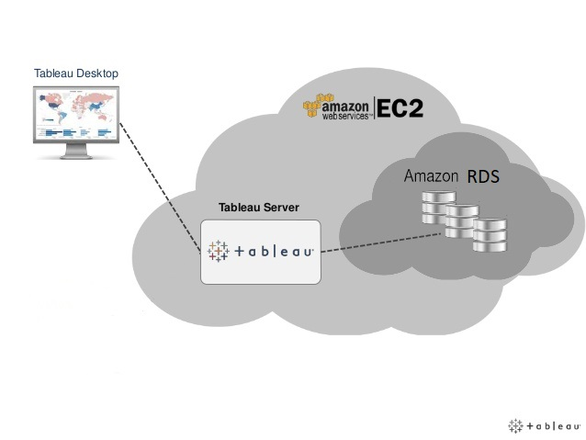
Architecture
Source: Tableau.com

Slide 9
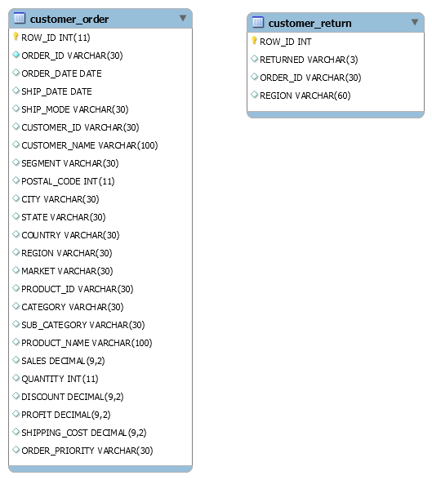
ERD Sample Data

Slide 10
Thank You

